Slide 1


CSE470:Software Engineering
video lecture series produced by:
A.M.Esfar-E-Alam
Afrina Khatun
Dr.Muhammad Zavid Parvez
Hossain Arif

Slide 2
Software measurement and metrics
Software measurement is concerned with deriving a numeric value for an attribute of a software product or process.
This allows for objective comparisons between techniques and processes.
Although some companies have introduced measurement programmes, most organisations still don’t make systematic use of software measurement.
There are few established standards in this area

Slide 3
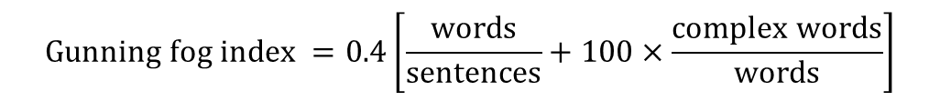
Software metric
Any type of measurement which relates to a software system, process or related documentation
Lines of code in a program, the Fog index, number of person-days required to develop a component.
Allow the software and the software process to be quantified.
May be used to predict product attributes or to control the software process.
Product metrics can be used for general predictions or to identify anomalous components.
$$Gunning fog index =0.4\left[\frac{words}{sentences}+100×\frac{complex words}{words}\right]$$

Slide 4
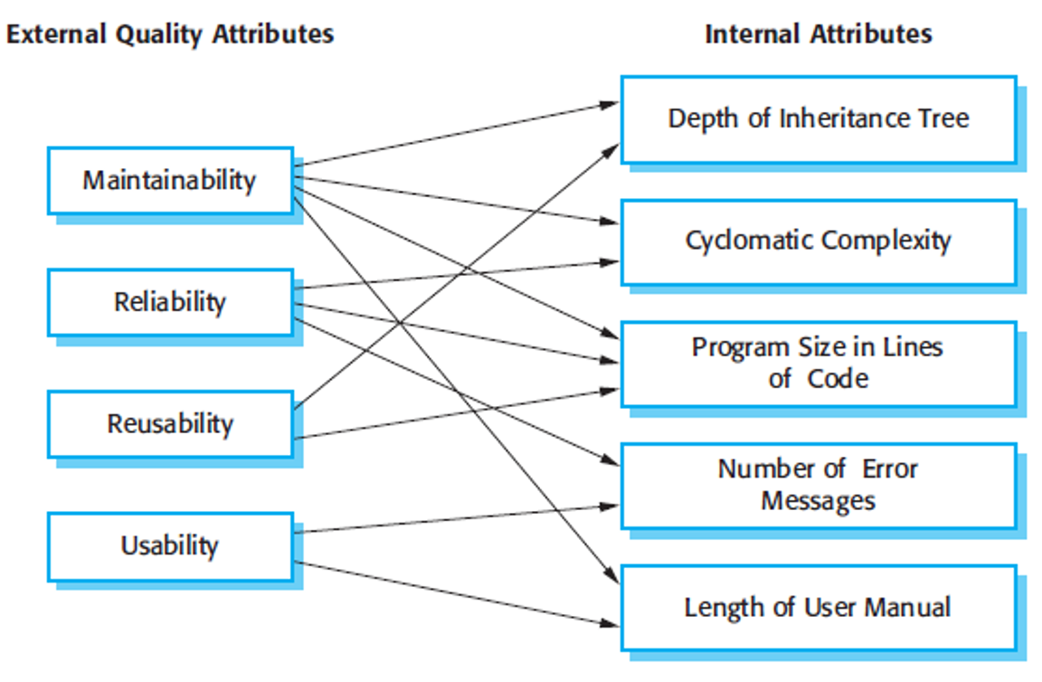
Relationships between internal and external software

Slide 5
Product metrics
A quality metric should be a predictor of product quality.
Classes of product metric
Dynamic metrics which are collected by measurements made of a program in execution;
Static metrics which are collected by measurements made of the system representations;
Dynamic metrics help assess efficiency and reliability
Static metrics help assess complexity, understandability and maintainability.

Slide 6
Fan-in/Fan-out, Length of code
Fan-in/Fan-out
Fan-in is a measure of the number of functions or methods that call another function or method (say X). Fan-out is the number of functions that are called by function X. A high value for fan-in means that X is tightly coupled to the rest of the design and changes to X will have extensive knock-on effects. A high value for fan-out suggests that the overall complexity of X may be high because of the complexity of the control logic needed to coordinate the called components.
Length of code
This is a measure of the size of a program. Generally, the larger the size of the code of a component, the more complex and error-prone that component is likely to be. Length of code has been shown to be one of the most reliable metrics for predicting error-proneness in components

Slide 7
CYCLOMATIC COMPLEXITY
Cyclomatic complexity is a source code complexity measurement that is being correlated to a number of coding errors.
It is calculated by developing a Control Flow Graph of the code that measures the number of linearly-independent paths through a program module.
Lower the Program's cyclomatic complexity, lower the risk to modify and easier to understand. It can be represented using the below formula:
M = E − N + 2P,where
E = the number of edges of the graph.
N = the number of nodes of the graph.
P = the number of connected components.

Slide 8
The complexity M is then defined as
M = R + 1,
where R = the number of regions in the graph.
The complexity M is then defined as
M = P + 1,
where P = the number of predicate nodes in the graph.
These two formulas are easy to use

Slide 9
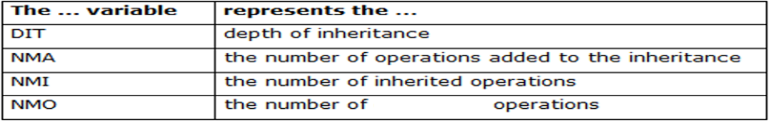
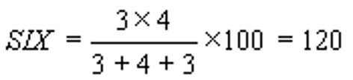
SPECIALIZATION INDEX (SIX)
The Specialization Index metric measures the extent to which subclasses override their ancestors classes. This index is the ratio between the number of overrid- den methods and total number of methods in a Class, weighted by the depth of inheritance for this class
The metric provides a percentage, where the class contains at least one operation. For a root class, the specialization indicator is zero. Nominal range is between 0 % and 120 %.
Example:
overridden

Slide 10
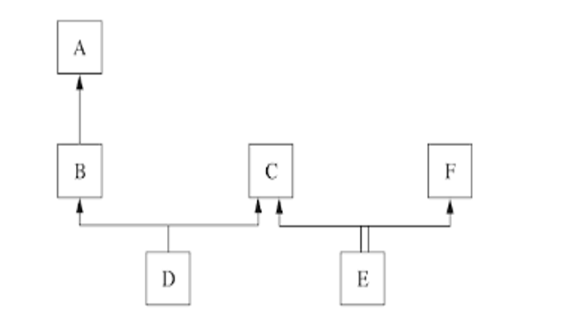
DIT(D) = 2
DIT(E) = 1

Slide 11
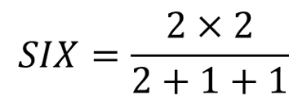
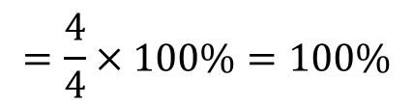
overridden
Class Person{
void read();
void display();
}
Class Student extends Person{
void read();
void display();
void getAverage();
}
Class GraduateStudent extends Student{
void read();
void display();
void workStatus();
}
NMO X DIT
NMO+NMA+NMI
SIX =
$$=\frac{4}{4}×100\%=100\%$$

Slide 12
DEFECT REMOVAL EFFICIENCY
A defect is found when the application does not conform to the requirement specification.
A mistake in coding is called Error
An average DRE score is usually around 85% across a full testing program.
DRE = E / (E + D) where:
E is the number of errors found before delivery of the software to the end-user
D is the number of defects found after delivery.
We found 100 defects during the testing phase and then later, say within 90 days after software release (in production), found five defects,
DRE = 100/(100+5) = 95.2%

